Slide 1

Resume Classification
Group 4

Slide 2
Team Members
Aishwarya Giri
Hritik Patil
Raghavendra Swamy
Sudha B K

Slide 3
Introduction
•Resume classification is the task of categorizing resumes into predefined job roles or domains. It involves extracting text from resumes, cleaning the data, and applying machine learning models.

Slide 4
Project Goals & Objectives
Objective 1
Objective 3
Objective 2
Extract text from resumes in various formats (PDF, DOCX, etc.)
•Evaluate model performance and optimize results
Clean and preprocess the extracted text.
Train a model to classify resumes into job domains

Slide 5
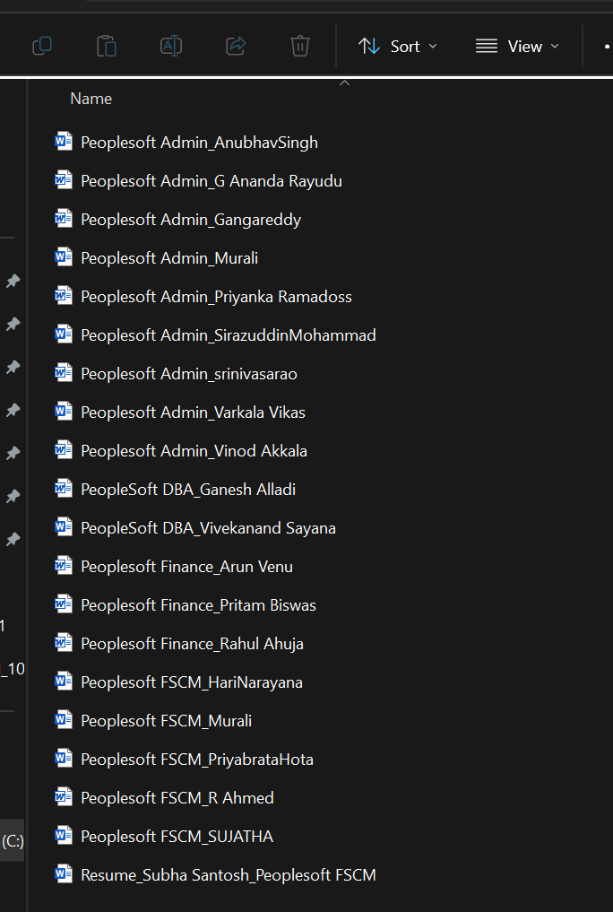
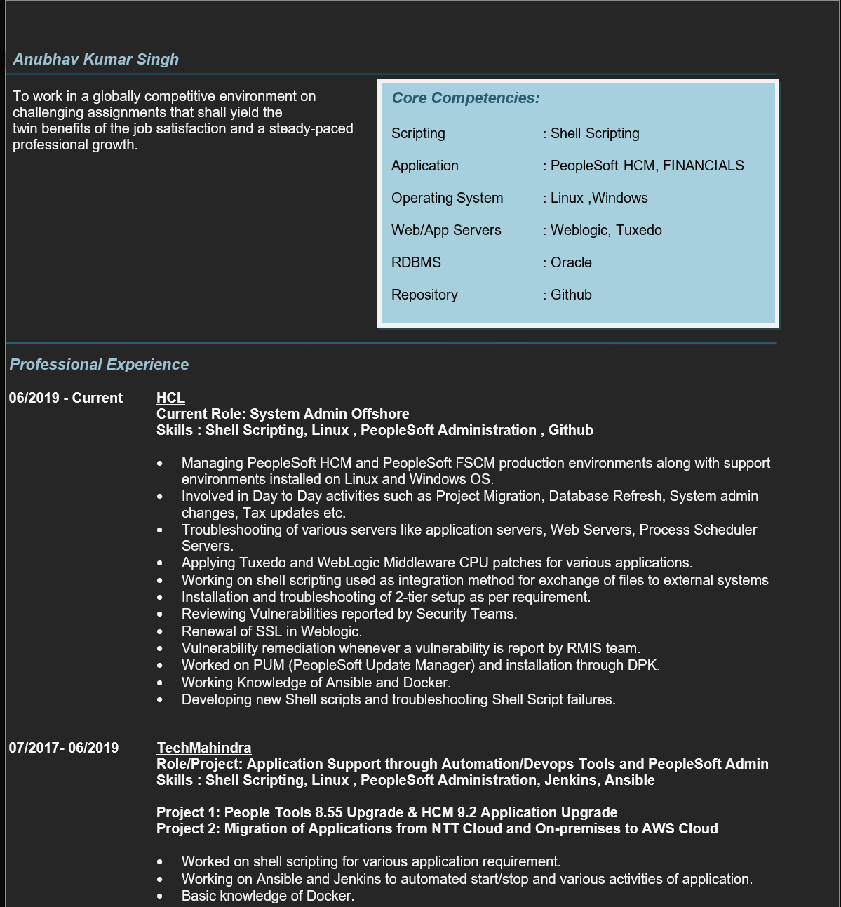
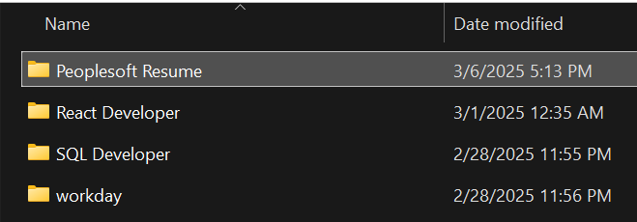
Dataset Overview:
•Resumes were collected from different sources
•Formats: DOCX, DOC, PDF, TXT
•Labels assigned based on job domains
•Cleaning involved removing extra spaces, formatting text

Slide 6
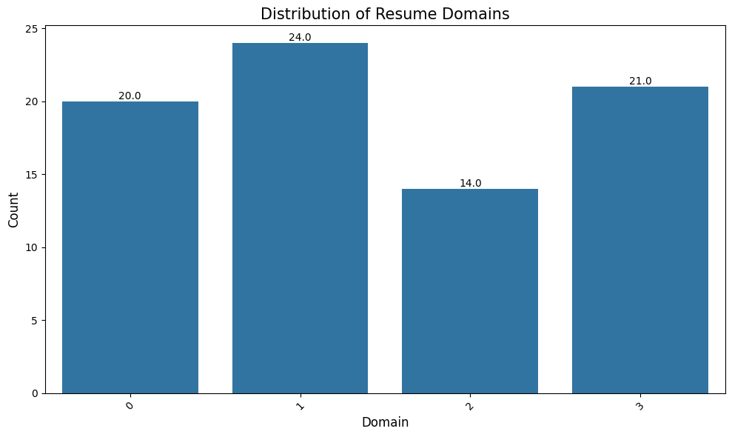
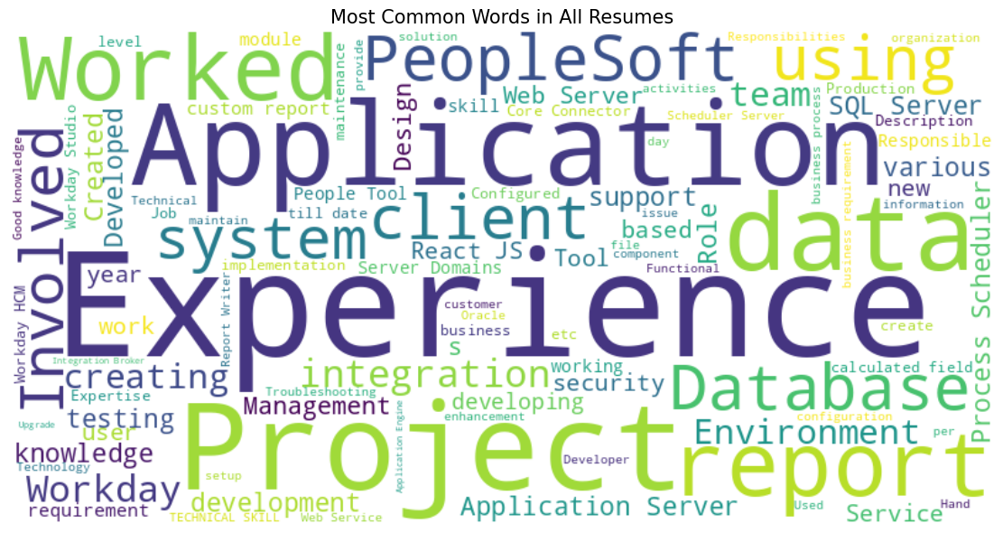
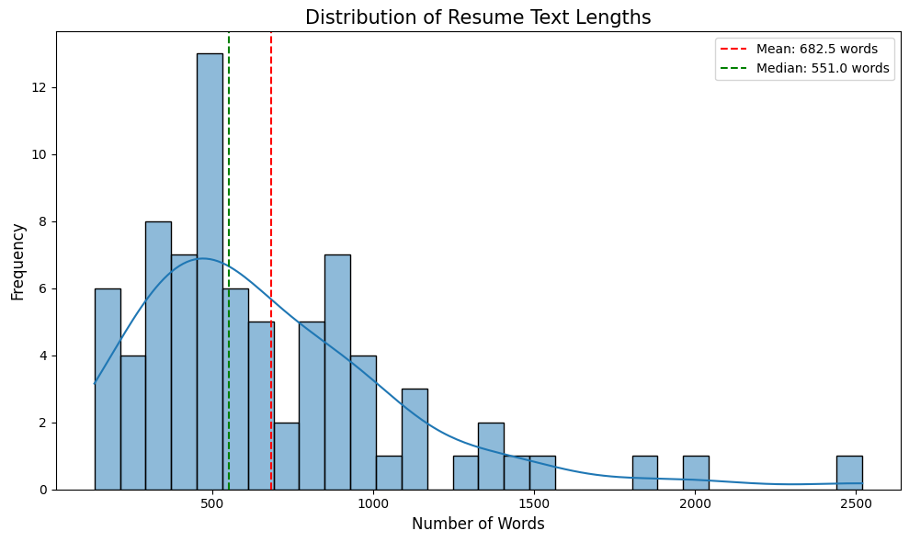
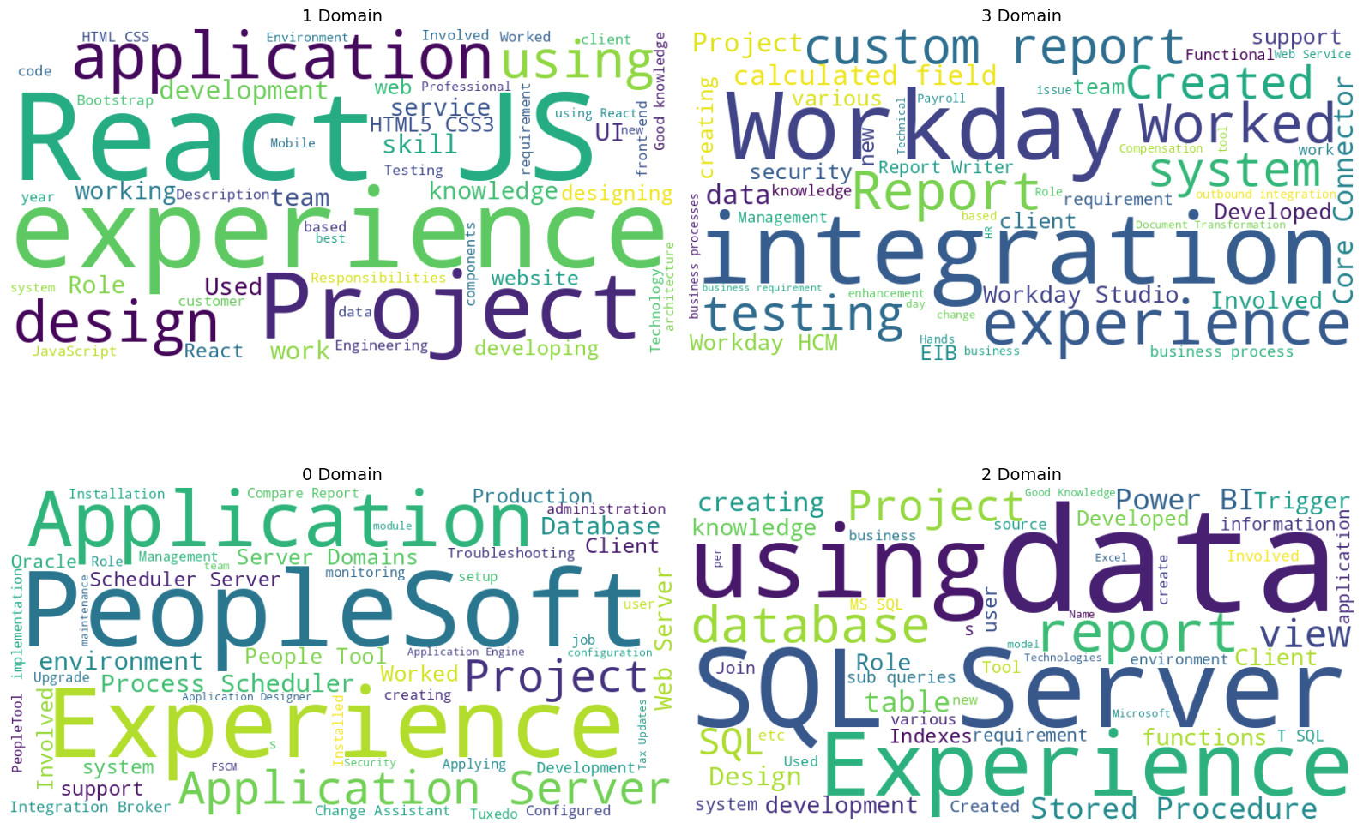
Before processing Text Data (Some Visualization)

Slide 7
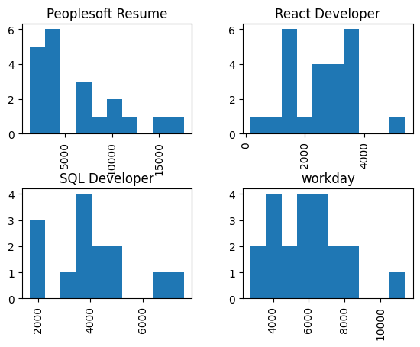
Category-wise length of Extracted Data

Slide 8
Text Preprocessing
Steps: •Defined a function to clean resume text
•Converted text to lowercase
•Removed non-alphabetic characters using regex
•Tokenized text and removed common stopwords
•Ensured only meaningful words remain for classification

Slide 9
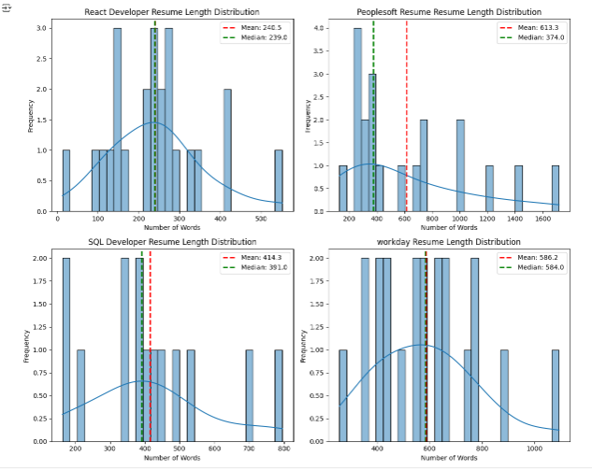
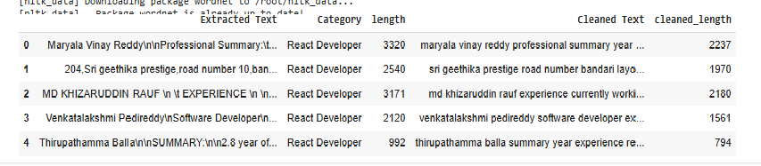
Change in Length of Data after Preprocessing

Slide 10
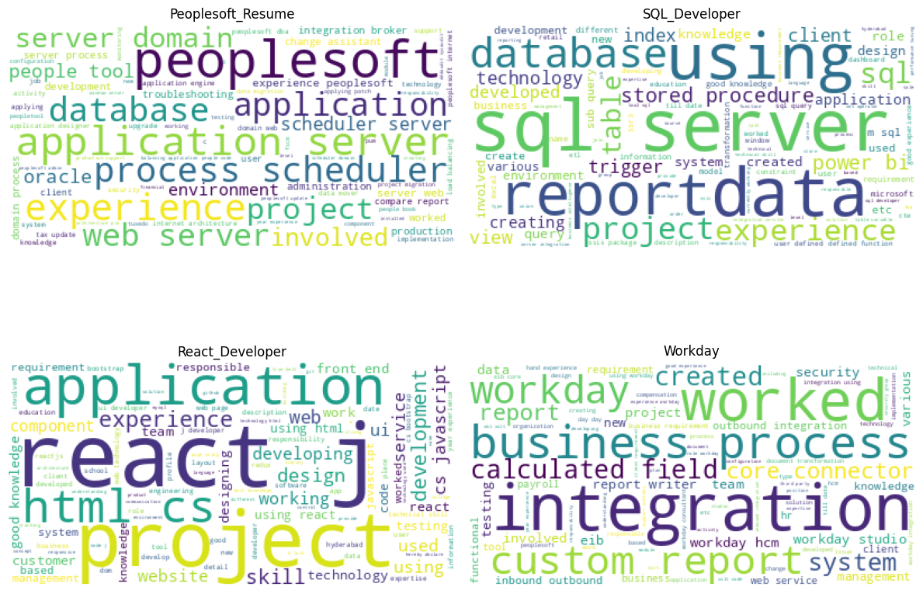
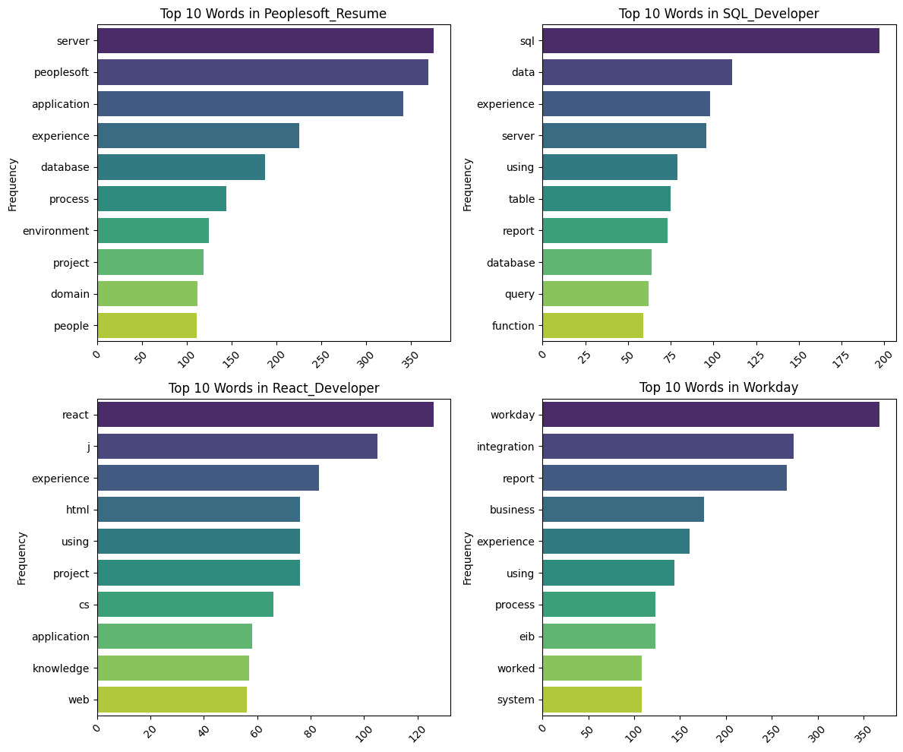
After processing Text Data (Some Visualization)

Slide 11
Model Building
Model building is crucial as it helps transform raw data into meaningful insights by identifying patterns and making predictions. It enables informed decision-making, improves efficiency, and drives innovation across various fields.
Naive Bayes
Support Vector Machine
Bagged Decision tree
Random Forest
Ada-Boost Classifier
Stacking Classifier
Light GBM
XG boost

Slide 12
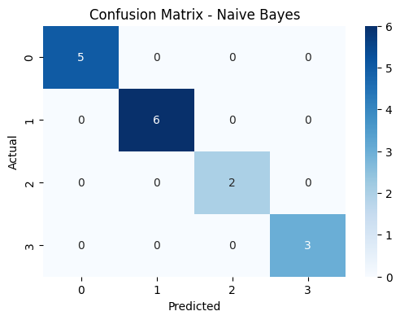
NAIVE BAYES
Naive Bayes is a simple yet powerful probabilistic classifier based on Bayes' Theorem, assuming independence between features. It is often used for text classification tasks like spam detection and sentiment analysis.
Naive Bayes
Classification Report:
 | precision | recall | f1-score | support
0 | 1.00 | 1.00 | 1.00 | 5
1 | 1.00 | 1.00 | 1.00 | 6
2 | 1.00 | 1.00 | 1.00 | 2
3 | 1.00 | 1.00 | 1.00 | 3
Accuracy Score:1.00

Slide 13
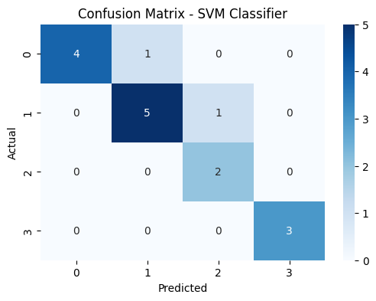
Support Vector Machine
Support Vector Machine (SVM) is a supervised learning model used for classification by finding the optimal hyperplane that best separates data points of different classes. It maximizes the margin between the closest points of each class, known as support vectors.
Support Vector Machine Classification Report:
 | precision | recall | F1_score | support
0 | 1.00 | 0.80 | 0.89 | 5
1 | 0.83 | 0.83 | 0.83 | 6
2 | 0.67 | 1.00 | 0.80 | 2
3 | 1.00 | 1.00 | 1.00 | 3
Accuracy Score: 0.88

Slide 14

Bagged Decision Tree
A Decision Tree is a supervised machine learning algorithm used for classification and regression, where data is split into branches based on feature conditions.
Decision tree
Classification report:
 | precision | recall | F1_socre | support
0 | 1.00 | 1.00 | 1.00 | 1.00
1 | 1.00 | 1.00 | 1.00 | 1.00
2 | 1.00 | 1.00 | 1.00 | 1.00
3 | 1.00 | 1.00 | 1.00 | 1.00
Accuracy score : 1.0

Slide 15
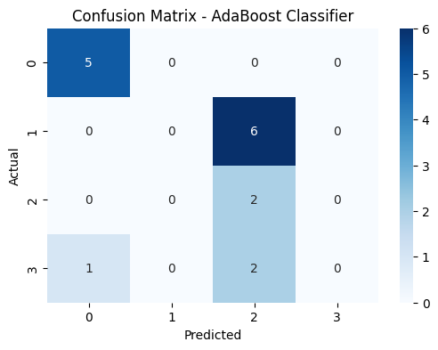
Ada-Boost Classifier
AdaBoost means Adaptive Boosting and it is a is a powerful ensemble learning technique that combines multiple weak classifiers to create a strong classifier. It works by sequentially adding classifiers to correct the errors made by previous models giving more weight to the misclassified data points.
AdaBoost
Classification Report:
 | precision | recall | F1_sorce | support
0 | 0.83 | 1.00 | 0.91 | 5
1 | 0.00 | 0.00 | 0.00 | 6
2 | 0.20 | 1.00 | 0.33 | 2
3 | 0.00 | 0.00 | 0.00 | 3
Accuracy Score: 0.44

Slide 16
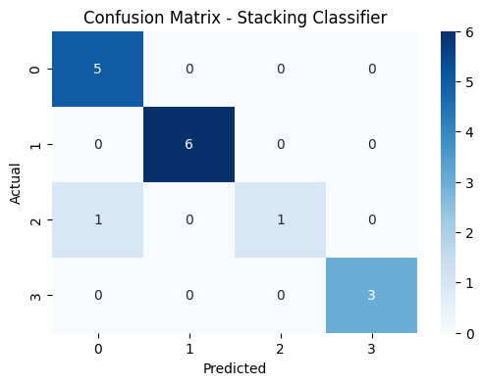
Stacking Classifier
Stacking is a powerful ensemble technique used in machine learning to improve the performance of models by combining the predictions of multiple models. Models used are Logistic,Decision Tree,SVM and for final Voting Classifier is used.
Stacking Classifier Classification Report:
 | precision | recall | F1_sorce | support
0 | 0.83 | 1.00 | 0.91 | 5
1 | 1.00 | 1.00 | 1.00 | 6
2 | 1.00 | 0.50 | 0.67 | 2
3 | 1.00 | 1.00 | 1.00 | 3
Accuracy Score: 0.94

Slide 17
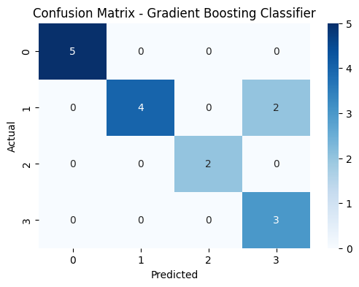
Light GBM
Light GBM is a gradient boosting framework that uses tree-based learning algorithms, designed for speed and efficiency. It splits trees leaf-wise rather than level-wise, which reduces loss more effectively and makes it faster for large datasets.
Light GBM
Classification Report:
 | precision | recall | F1_sorce | support
0 | 1.00 | 1.00 | 1.00 | 5
1 | 1.00 | 0.67 | 0.80 | 6
2 | 1.00 | 1.00 | 1.00 | 2
3 | 0.60 | 1.00 | 0.75 | 3
Accuracy Score: 0.88

Slide 18
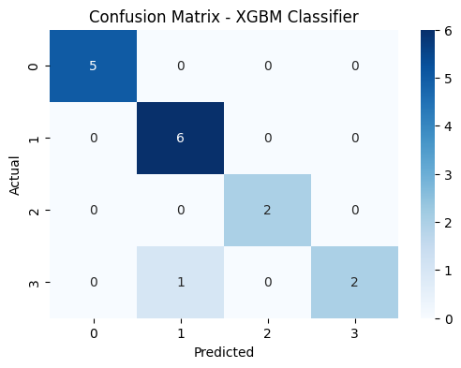
XGBOOST
The XG Boost model is a powerful, scalable machine learning algorithm based on gradient boosting, used for both classification and regression tasks. It works by building an ensemble of decision trees, where each new tree corrects the errors made by the previous ones, optimizing for speed and performance.
XG Boost
Classification Report:
 | precision | recall | F1_sorce | support
0 | 0.83 | 1.00 | 0.91 | 5
1 | 1.00 | 1.00 | 1.00 | 6
2 | 1.00 | 0.50 | 0.67 | 2
3 | 1.00 | 1.00 | 1.00 | 3
Accuracy Score: 0.9375

Slide 19
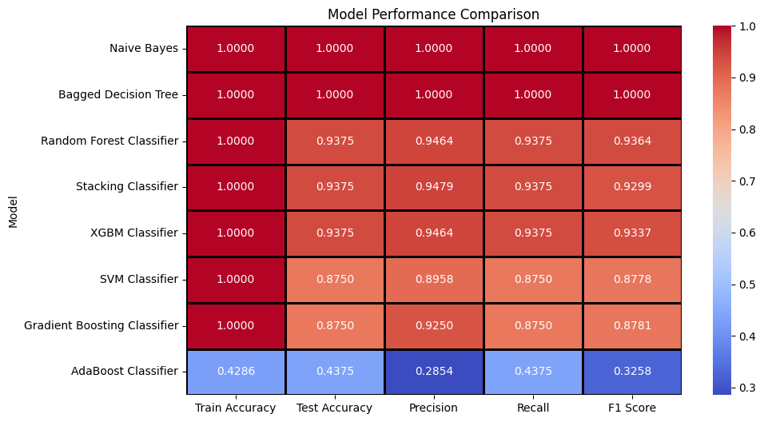
Model Evaluation

Slide 20
Deployment-Final Model
In machine learning, deployment refers to the process of integrating a trained model into a production environment, making it accessible for real-time predictions or decisions
XGBM:-
XGBoost (Extreme Gradient Boosting) often outperforms Random Forest and stacking methods, particularly in complex scenarios, due to its ability to handle large datasets, imbalanced data, and its fine-tuned hyperparameter control, which leads to superior predictive accuracy.
Therefore it is selected as a final model for this project.

Slide 21
Steps for Final Model-Building:
Raw Resume Text (df['Extracted Text'])
↓
Text Preprocessing (remove punctuation, lowercase, lemmatization, stopwords)
↓
CountVectorizer (Convert text into a word frequency matrix → X)
↓
OrdinalEncoder (Convert categories into numbers → y)
↓
Train-Test Split (X_train, X_test, y_train, y_test)
↓
XGBoost Classifier (Builds multiple decision trees)
↓
Predict Job Category for New Resumes

Slide 22
Deployment Steps
Jupyter:-
Creating Final Model-Xgbm and saving its pickle file. Also saving Vectorization and label encoding as pickle files.
Spyder:-
It is a Python IDE, to develop and run Streamlit applications.
CSS(Casading style sheets) is used to make app look more presentable
3. Streamlit:-
Streamlit is a popular open-source framework used for model deployment by machine learning and data science teams. And the best part is it’s free of cost and purely in python.

Slide 23
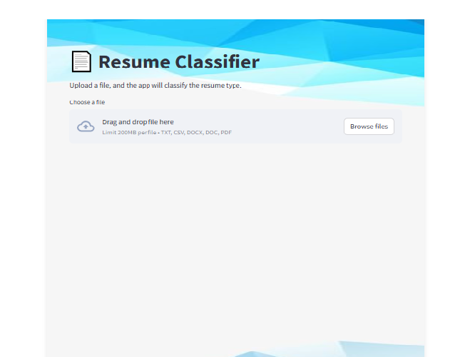
Resume Classifier App

Slide 24
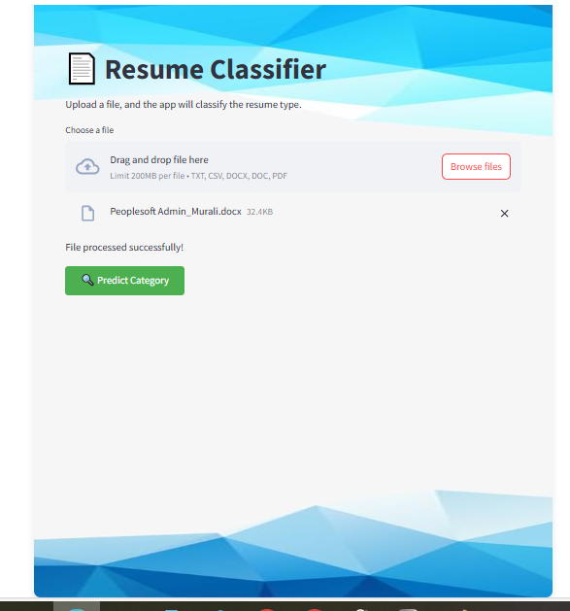
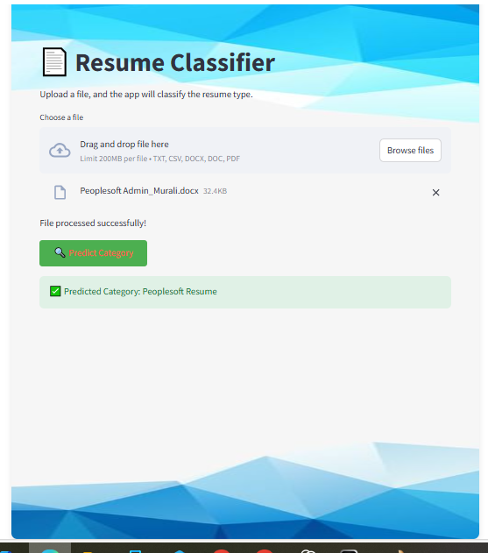

Slide 25
Challenges and Solutions:-
1. Different Resume Formats Challenge: Resumes came in PDF, DOCX, DOC, and TXT formats. Why it’s hard: Some files may not extract text properly (especially scanned PDFs or images).
Solution: Use strong text extraction libraries like pdfminer, docx, or OCR tools for image-based resumes.🧹
2. Messy Text Data Challenge: Resume text is often unstructured and inconsistent. Why it’s hard: Some resumes may include symbols, bullet points, or special formatting that breaks the text.
Solution: Careful text cleaning — removing noise, punctuation, converting to lowercase, etc.🏷
3. Labeling the Data Challenge: Each resume had to be given a job domain (like Data Science, Web Dev, etc.)Why it’s hard: If labeling was done manually, it’s time-consuming and subjective.
Solution: Use clear rules or domain knowledge while assigning labels, or semi-automate the process if possible.
4. Imbalanced Dataset Challenge: Some job categories might have more resumes than others. Why it’s hard: Models learn more from the majority class and ignore the minority ones.
Solution: Use balancing techniques like oversampling, undersampling, or algorithms like XGBoost which handle imbalance better.

Slide 26
5. Choosing the Right Model Challenge: So many ML models (Naive Bayes, SVM, XGBoost, etc.) — how do you know which works best? Why it’s hard: Every model has strengths and weaknesses with text data.
Solution: Try multiple models and compare performance using accuracy, confusion matrix, etc
6. Model Evaluation Challenge: You need more than just accuracy — what if the model predicts all resumes as the majority class?
Solution: Use confusion matrix, precision, recall, and F1-score to fully understand performance.🌐
7. Deployment Challenge: Putting the model into a working app using Streamlit. Why it’s hard: Connecting model code, front-end interface, and text processing in real time.
Solution: Use a clear flow: preprocessing → prediction → user output, and handle errors properly.
8. Maintaining the Model Challenge: New types of resumes may not work well with the old model.
Solution: Keep updating the model with fresh resumes and retrain regularly.

Slide 27
Future Agenda
🛠 Agenda for Future Work
1. Improve Resume Text Extraction
Handle scanned or image-based resumes using OCR.
Improve extraction accuracy from messy PDF formats.
2. Enhance Labeling Process
Automate job category labeling using keyword matching or GPT-based tools.
Add more categories to cover wider job roles.
3. Balance the Dataseto Add more resumes in under-represented categories.o Use techniques like SMOTE for balancing.
4. Try Deep Learning Modelso Test models like BERT or LSTM for better text understanding.o Compare with traditional models like XGBoost.
5. Add Resume Scoringo Not just classify — also rate resumes based on job fit.o Helpful for recruiters to filter best matches.
6. Build a User Dashboardo Create a web interface where users can upload resumes and see results in real time.o Add charts and summaries to make it more user-friendly.
7. Deploy in Cloudo Host the app on platforms like Heroku, AWS, or Streamlit Cloud for public access.
8. Collect Feedbacko Let users review predictions and give feedback to improve the model over time.

Slide 28
Thank You

